Slide 1


Slide 2
Education Improvement Program Swabi
Goal
Objectives
To ensure Community Active Participation in Project Implementation
To ensure Gender Inclusion (Education for all )
To ensure Capacity Building of Teachers/students/PTAs/PTCs
To ensure Strengthening of Educational Institutions
Social Mobilization
PTA/PTC Meetings)
Ulama Conference for education importance(PTA/PTC meetings)
Provision of Teaching AIDs
Coordination and Linkages between different schools, Edu-Deptt, Local Govt, Organization
Distribution of printed materials for awareness-IEC materials
Education Specialist Selection/Tasks
Baseline Survey
Teachers Trainings
PTAs/PTCs Trainings
Demo Teaching
Community grand meetings/BBCM
Identification of School Problems through community
PTAs/PTCs meetings
Baseline Survey of the Schools
Capacity Building of PTAs/PTCs
15% project Cost share (Material, Cash, Food, Labor, Accommodation)
Teachers Trainings
Monitoring and supervision
Mobilization towards Education
PTA/PTC Meetings
School Social Survey
Resolution from school
Technical Survey
Feasibility Report
School Sketches
GPS reading pictures
Renovation of School
Safe drinking water supply
Provision of Desk/Benches
Provision of bags uniform and other educational materials
Provision of Sports Materials
Provision of Staff furniture
Social Mobilization / Special campaign for female education(PTA/PTC Meetings)
Involvement of religious leaders( PTAs/PTCs Meetings)
Modern Teaching
Special awareness sessions
Main Activities

Slide 3
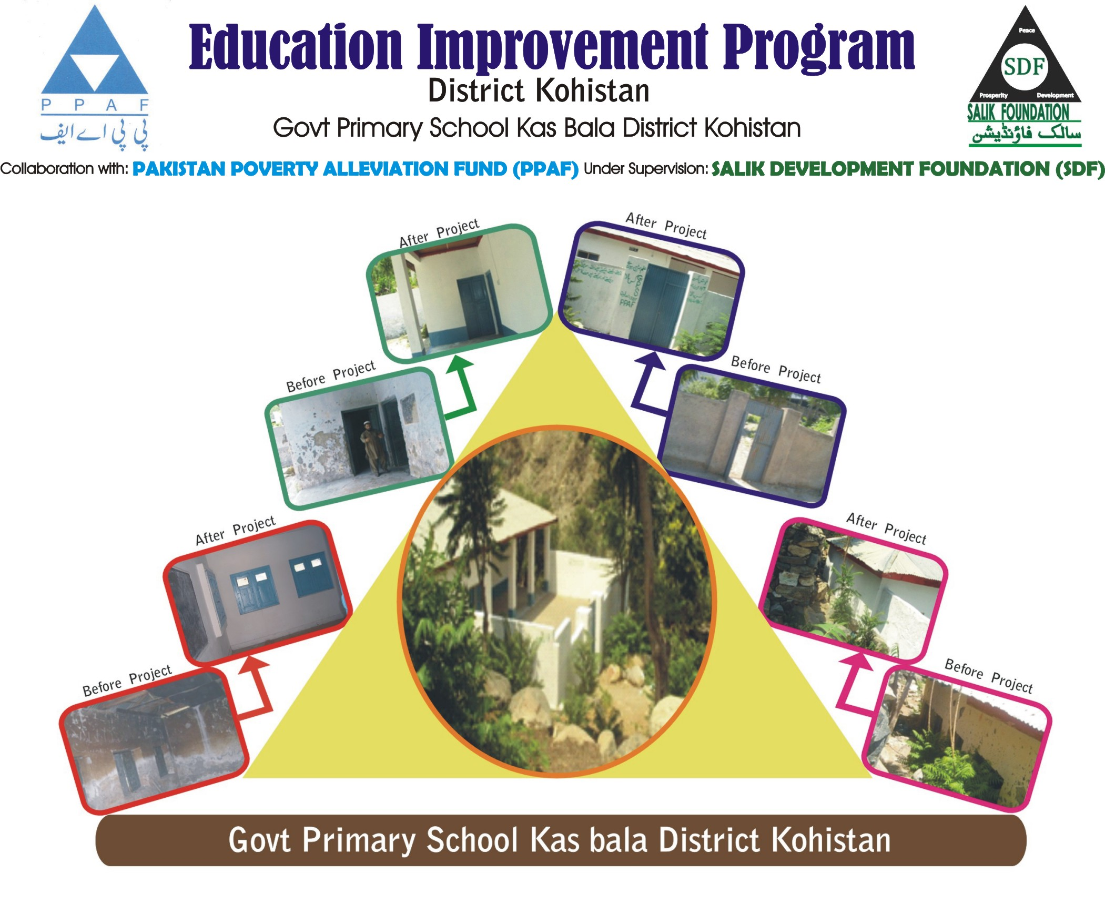
.
Previous experience-repair and renovation

Slide 4
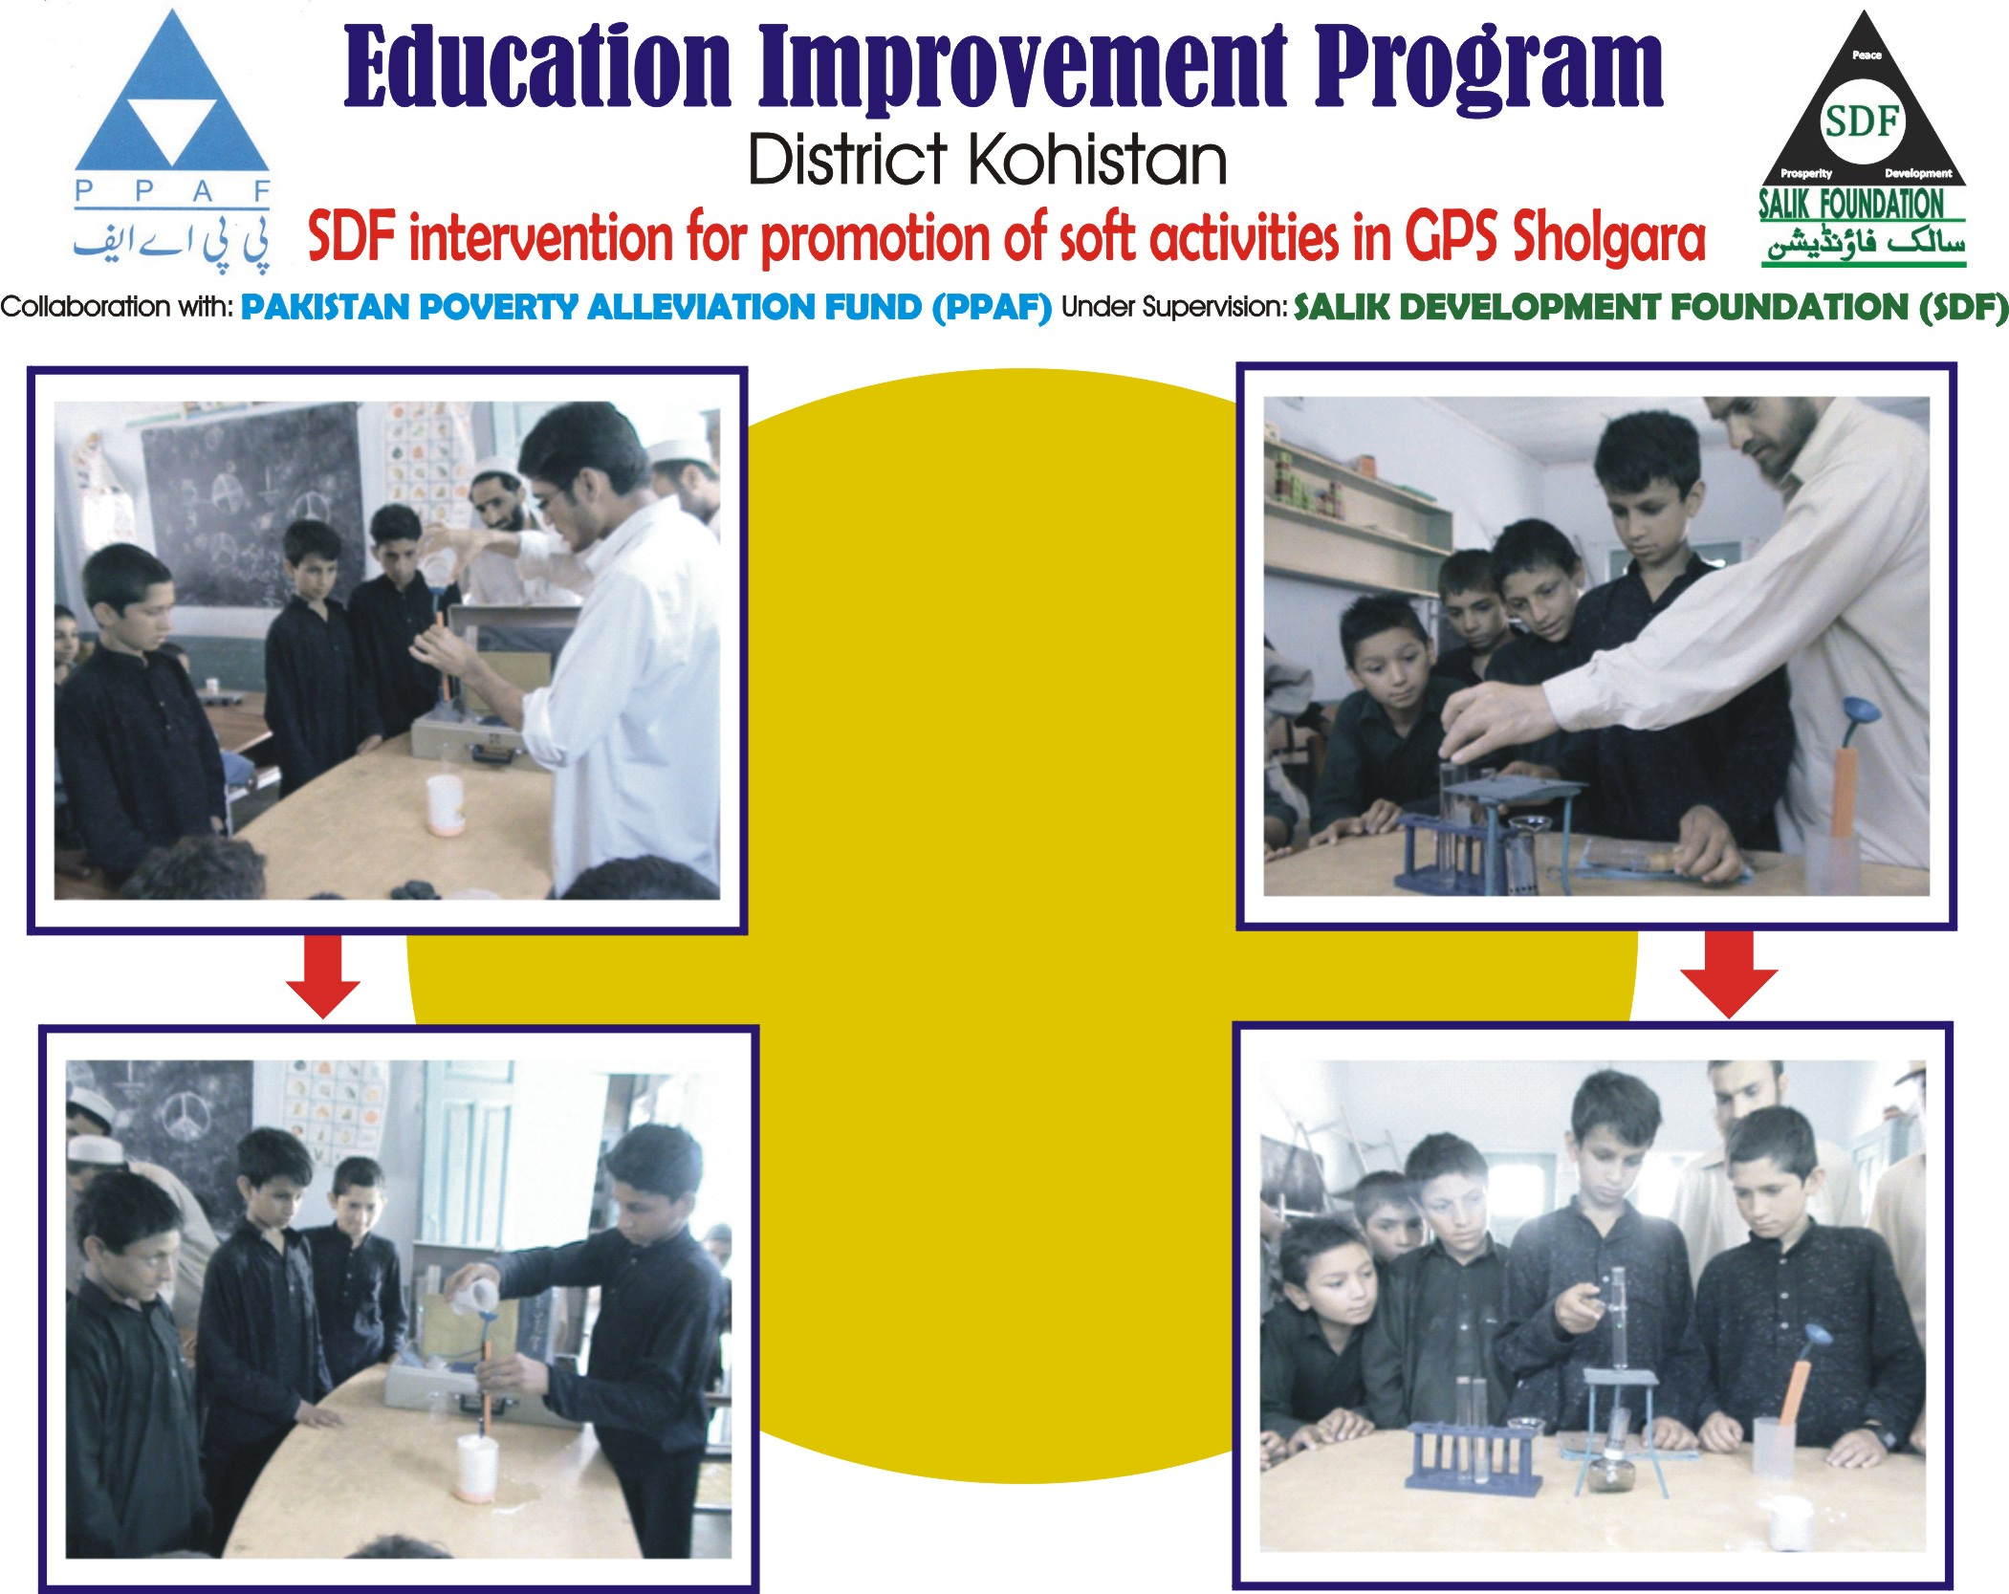
Previous experience Soft Activities
Previous experience-Soft Activities

Slide 5
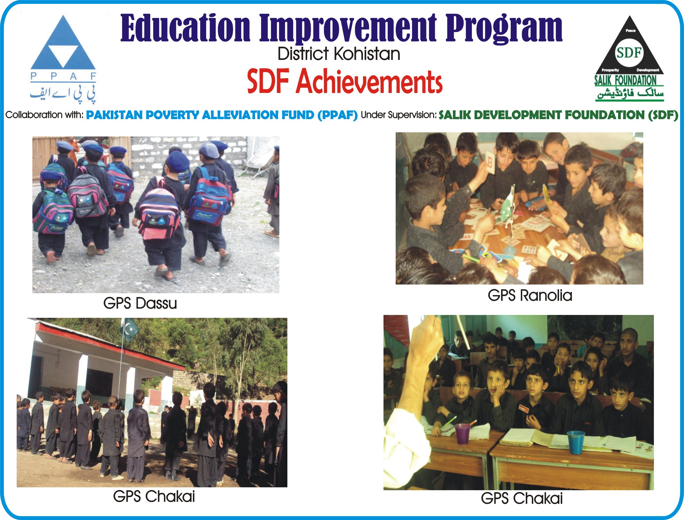
Educational Environment in Schools
Education improvement in schools
Previous experience Soft Activities

Slide 6
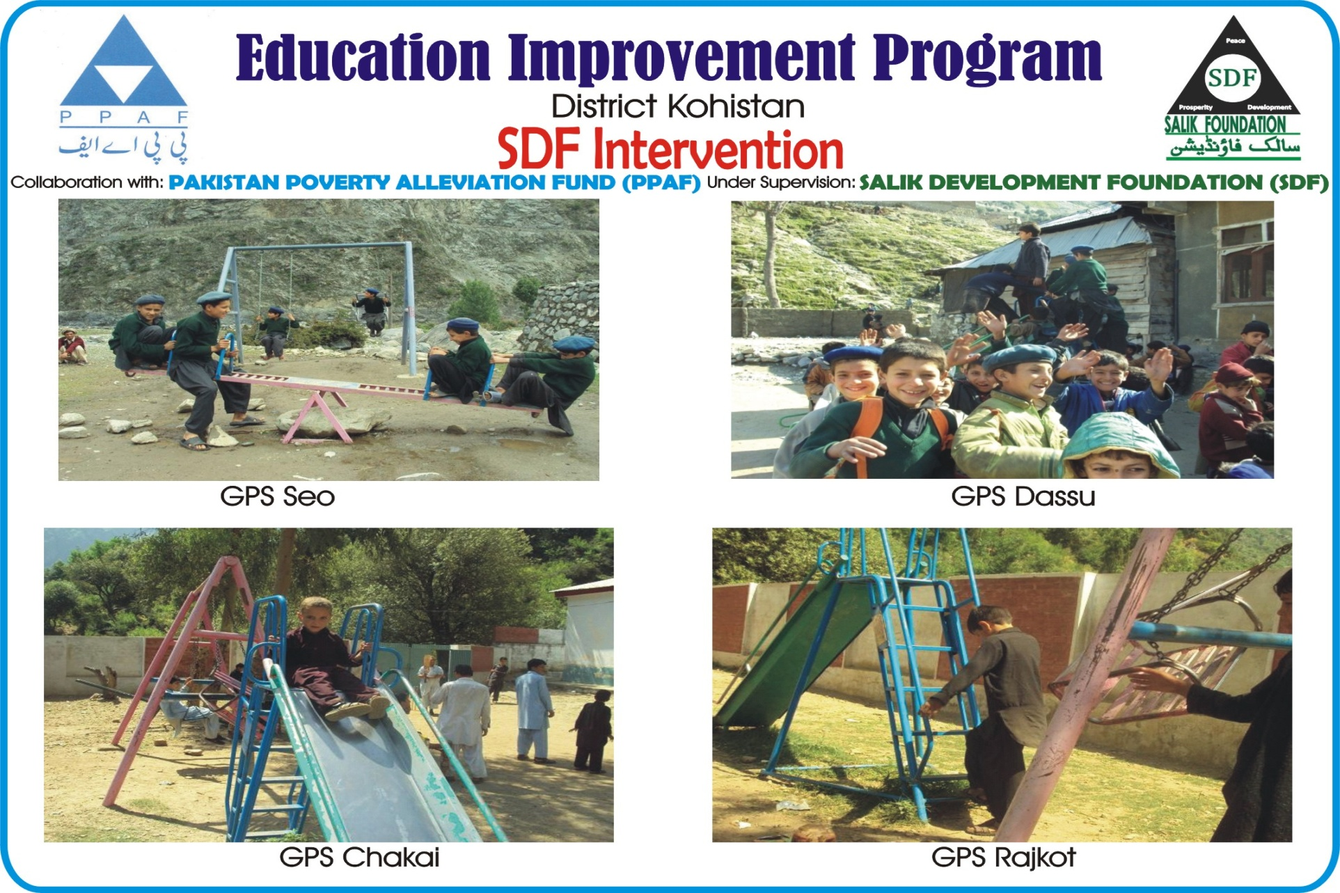
Swings/Installation of Sports materials
Swings/Installation of Sports materials

Slide 7
Education Improvement Program Swabi
Project Duration: 2.5 years
Commencement Date: November, 2012
Ending Date: April, 2015
Tehsil: Razzar
Union Councils: Sard Cheena & Yaqoobi
Total Schools: 13
S/No | Name U/C | Male Schools | Female Schools | Total Schools
1 | Sard Cheena | 05 | 02 | 07
2 | Yaqoobi | 04 | 02 | 06
Total |  | 9 | 04 | 13

Slide 8
List of Schools
S/No | Name school | U/C | Tehsil
1 | GGPS No-2 Sard Cheena | Sard Cheena | Razzar
2 | GGPS Sard Cheena No 1 | Sard Cheena | Razzar
3 | GPS NO 1 Rohani | Sard Cheena | Razzar
4 | GPS No-1 Bazargay | Sard Cheena | Razzar
5 | GPS No-2 Sard Cheena | Sard Cheena | Razzar
6 | GPS Sard Cheena No 1 | Sard Cheena | Razzar
7 | GPS Sher Abad | Sard Cheena | Razzar
8 | GGPS Akhtar abad yaqoobi | Yaqoobi | Razzar
9 | GGPS No 1 Yaqoobi | Yaqoobi | Razzar
10 | GPS Maskeen Abad | Yaqoobi | Razzar
11 | GPS NO 2 BAKYANA | Yaqoobi | Razzar
12 | GPS No 1 Yaqoobi | Yaqoobi | Razzar
13 | GPS Shadad Kalay | Yaqoobi | Razzar
Total

Slide 9
Education Improvement Program Swabi
Two types of Activities
Hard Activities
Soft Activities

Slide 10
Hard activities
Renovation of Schools
Provision of sports material
Repair of School Furniture (Staff & Students)
Provision of New furniture (Staff & Students)
Provision of Stationary/Teaching Aids
Provision of Students Bags/Uniform
Provision of Learning Kits
Provision of Teaching Kits
Provision of additional teachers to each school

Slide 11
Soft Activities
Mobilization towards Education
School Vision
SDP
PTC Reactivation
School Basic Empowerment in Education
School Management
Class Room Management
Students Participation in Education
Parents/Community/Stakeholders, Religious Leaders involvement in Education
Activity Base Learning
Teachers/ PTC Trainings

Slide 12
THANKS

Slide 13


Questions ?

